Slide 1
Warp Camera Effect
A Unity tutorial for warp and hyperdrive charge effects for the camera using a code based solution
GitHub repository for this project

Slide 2
The goal of this tutorial is to create a simple camera effect which will change the camera’s field of view (FOV) to make it appear as if a warp or hyperdrive is charging up. In this tutorial we will be using C# as our chosen programming language.

Slide 3
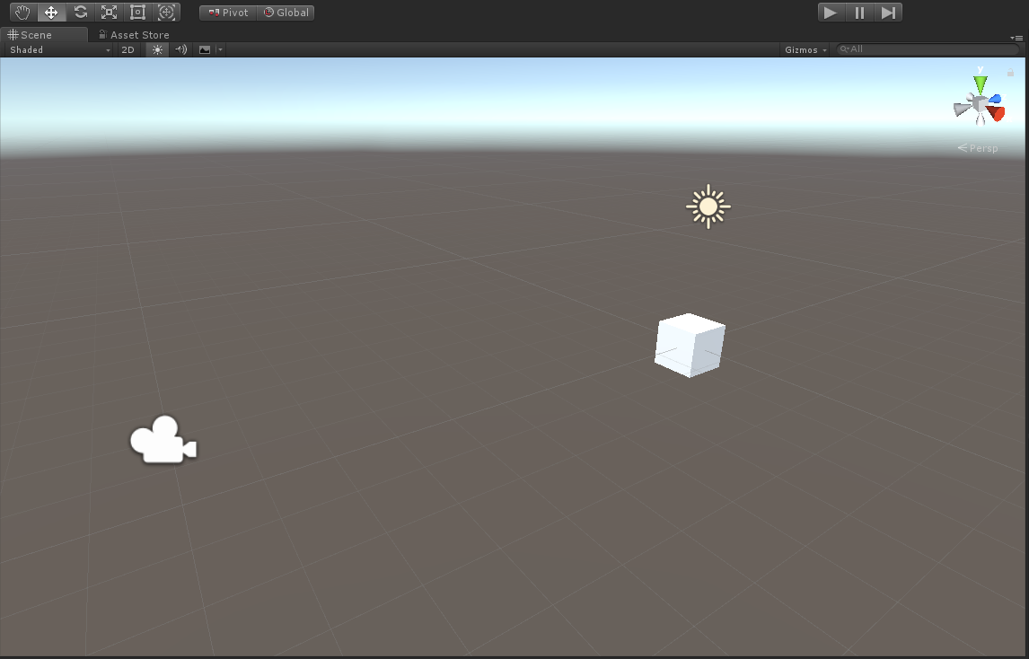
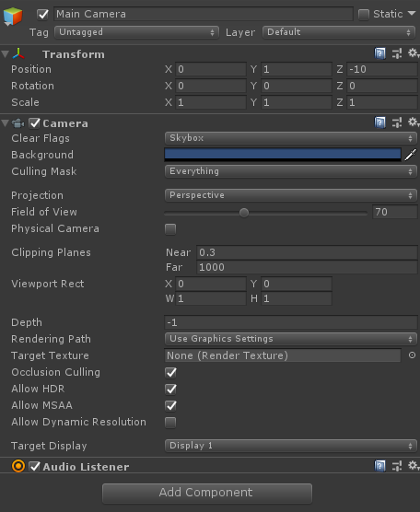
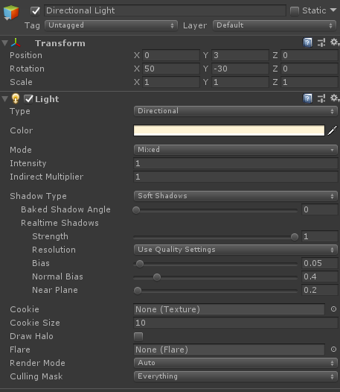
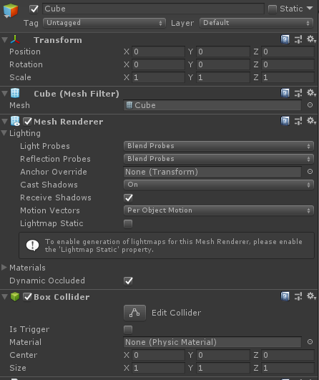
To start off, let’s start by creating a new Unity project. Let’s place the camera and light at two locations. We’ll also add a cube in to give us some perspective on how well the warp effect is.

Slide 4
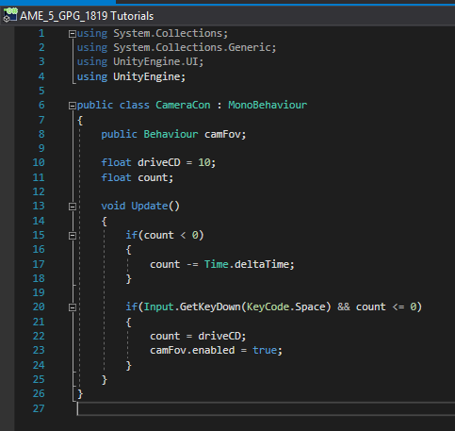
Next we’ll create and add out first script. This will be the main script which controls the second behavior script. We’ll need to declare 3 variables: - A Public Behaviour called camFov to hold our second script/behavior - A Private float called driveCD to hold our cooldown value - Another Private float called count to count down from the cooldown variable when the behavior is activated

Slide 5
Next we’ll create an if statement to check if count is greater than 0 and, if true, then subtract the time taken to complete the last frame using Time.deltaTime. We can then use count as part of our condition when the user attempts to activate the hyperdrive and trigger the camera effect

Slide 6
Finally we’ll create a second if statement to check if the space bar has been pressed and that count is less or equal to 0. To check if space bar has been pressed we use Input.GetKeyDown(KeyCode.Space). This will check on the frame it was called on to see if the space bar has been pressed. Then we can reset the count to the value of driveCD and start our behavior by referencing the variable camFov and setting .enabled to true.

Slide 7
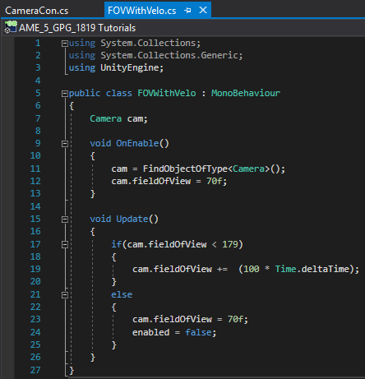
Now we can work on our behavior script. For this we’ll only need one variable which will hold a reference to the camera in our scene, Camera cam. Next we will use the void OnEnable() method which will be called when the behavior is enabled in our main script. Inside this method we will set , to the camera in the scene using FindObjectOfType< Camera >(). This will find and return the first active camera listed in the hierarchy of our project. Lastly we will set the FOV of cam to 70 as a base value.

Slide 8
Next we will make use of another if statement statement in the Update method to increase the FOV of the camera. As our condition we will use the current FOV of our camera cam. If the FOV of cam is less than 179, the maximum FOV of a camera in Unity, we will then increase it’s FOV by Time.deltaTime multiplied by 100. Using Time.deltaTime will ensure a smooth change in FOV.

Slide 9
Now using an else connected to the previous if statement we can reset the FOV of cam to 70 to show that the sequence has been complete and disable the behavior by setting enabled equaled to false.

Slide 10
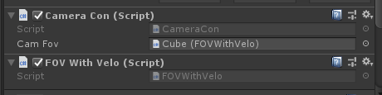
Lastly we can return to Unity an attach the main script and the behavior script to an object of our choosing, in my case I used the cube created earlier. Attach both scripts but disable the behavior script and drag and drop in into the slot on the main script where it requires a behavior.

Slide 11
/ / /**END OF TUTORIAL** / / /**TRANSMISSION TERMINATED**

